Slide 1
AWS & Ecommerce Integration
(www.rapidsgroup.com)
www.therapidsgroup.com
Business Intelligence & eCommerce Solutions Premier Global Provider
Margate City, NJ

Slide 2
Agenda
Items on Agenda that we will address as part of this proposal presentation
Industry Trends
High Level Scope
Design Strategy
Technology Stack
Project Implementation
Expectations

Slide 3
Industry Trends
Need to meet changing preferences was due yesterday..
A Proven need to evolve to Changing Customer Expectations
71%
of B2B buyers said they would switch suppliers to one with a better overall digital experience
82%
of B2B buyers say that they have used online platform or website to make a purchase for work

Slide 4
Industry Trends..
According to Fact based Statistics, a B2B vendor’s website is the primary channel through which clients engage with the brand.
The importance of an organized and search friendly website that loads quickly and have agility to respond to a rapidly changing environment, that can incorporate integrations and functionality for their businesses is a must-have
How can our business do that?

Slide 5
Industry Trends..
Simply by following –
5 Rules for Creating Engaging B2B Web Experiences
Rule #1: Personalization Drives Sales
Rule #2: Ease of Use and Transparency are essential
Rule #3: Omni channel experiences empower customers
Rule #4: Product Selection, Content and Merchandizing are differentiators
Rule #5: Online channels are an extension of your Sales Team, Definitely not a Replacement for it

Slide 6
High Level Scope
Complete infrastructure deployment leveraging Amazon Web Services (AWS) server combinations for codes, database, cache and images with CDN for faster delivery of images
An eCommerce website on Magneto platform with user experience and theme based on client’s requirements
Integration with ERP (Currently, QuickBooks)
Mobile applications will be based on the Magento REST API and Some Custom API extensions

Slide 7
Design Strategy
Complete design strategy is based on following guidelines…
The core tech stack will include PHP based Magento ecommerce platform. Custom libraries and JWT token based Rest API authentication. Initially we will use MySql for RDBMS and Redis for in-memory cache for faster processes
Configure Magento, Admin Panel, User Panel to manage all the categories/ sub categories and products as per client’s requirements
Adapt and develop a Magento theme based on client’s requirements to provide an intuitive user experience

Slide 8
Design Strategy
Setup extensions for customers to see bestsellers, most searched and related/recommended products based on recent search history of the visitors and deliver content in proper context
Design the UI of mobile applications using latest Ionic and Angular for both platforms i.e. Android and IOS leveraging Magento 2 REST API to enable mobile compatibility. Parallel efforts to launch the application on play store and app store.
Enable different services from AWS i.e. EC2 Instances for hosting codes, RDS for hosting RDBMS database, S3 buckets for images..

Slide 9
Technology Stack
Server Infrastructure
Cloud Technology Amazon Web Services (Lightsail, EC2 Instance, RDS, S3 buckets) – LINUX Bases Systems
Web Backend
- Core Tech Stack (PHP; MySQL)
- Frameworks/CMS (Magento 2.3.x; Extensions; REST API)
Web Front End
- Core Tech Stack (HTML; CSS, JS)
- Frameworks (Bootstrap, Angular, Vue.js)
Mobile Application
Core Tech Stack (HTM5, SCSS 2, ANGULAR)
Frameworks (IONIC 5; Third party APIs)

Slide 10
Technology Stack
Justification - Why this Technology?
Amazon Web Services (AWS) – A whitepaper by IDC, shows customers that migrate to AWS can experience 51% reduced costs of operations, 62% increased IT productivity, and 94% reductions in downtime
Why migrate to AWS Cloud?
31%
Avg infrastructure cost savings vs on premises *
10x
Fewer downtime hours compared to a non-cloud physical server*
24 Regions
and 76 availabile zones globally. Helps with Highavailability
62%
more efficient IT infrastructure & security mgmt vs on premises*

Slide 11
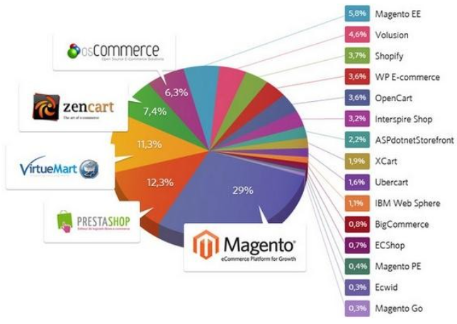
Technology Stack
Magento eCommerce Platform – Provides the core competencies like flexibility, scalability, ease-of-use, responsive design, transparency, personalization, and multi-channel dynamics that are essential for a successful B2B business
A robust, sturdy, platform - being used by more than 3,00,000 online stores, a number sure to outgrow with the new pace of digital economy

Slide 12
Technology Stack
Commerce Magento 2 Commerce Edition is the premium and paid version of Magento. It is completely supported by the Magento team and subscribers receive full customer service and support by phone and email. Pricing also includes security, advanced features and product improvements. Commerce Edition is operationally more scalable and is generally used by mid-sized to large retailers with higher throughputs of customer traffic, larger product catalogs, wider global presence and more complex business processes. | Open Source Magento 2 Open Source Edition is a platform available for free download and installation and it contains the same core features as it’s Enterprise counterpart. It is easily customizable and makes use of the Magento Marketplace and skilled technical resources to extend the core features and support specific business and functional requirements. Many large and mid-market retailers utilize Magento Open Source for their ecommerce platform and successfully meet ever expanding requirements and customer demands.

Slide 13
Project Implementation
1. Concept & Planning Phase
Like every project, everything starts from planning the concept. This phase requirements will need to be documented for landing page.
2. Design Phase & Technical Phase
Shortlist Modules. For Order, Shipping, ERP (QuickBooks) Integration
Identify the system requirements for planned website and register with AWS to create server instances
Configure Theme and all 3rd party integrations as needed
3. Testing
- Chuck & Ed - Stakeholders to test the new web portal on AWS
4. Deployment
- Agree on go-live date to launch the end product

Slide 14
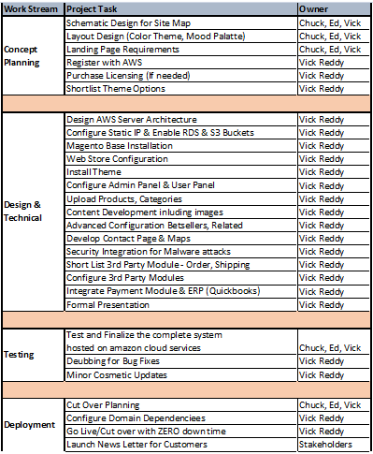
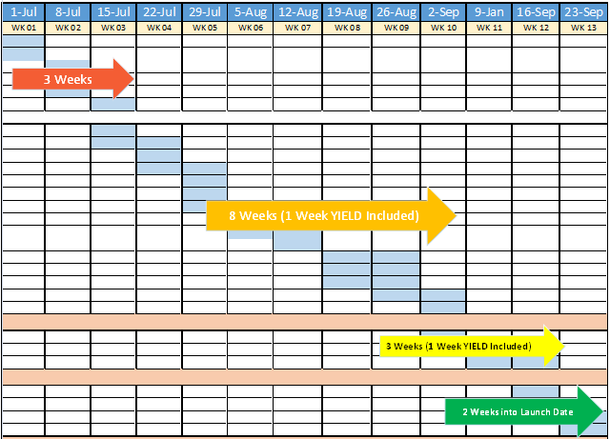
Project Implementation
Project Plan & Timelines..

Slide 15
Example Stores
Few example stores built on Magento
Magento Open Source based Portals
http://demo-magento2.vuestorefront.io/
https://www.nephora.com
https://www.uae.conektr.com
Magento Enterprise based Portals
https://www.jaguarusa.com
© Copyright 2020. Rapids Group Inc
15

Slide 16
Expectations
What you need to do now?
Invest Trust – for an end to end implementation
Relax, Chill & have a Drink on Beach post the project kick off...
CHEERS!

Slide 17
Thank you!
Thank you for the opportunity to put in this proposal
Questions (or) Comments please feel free to email
“Vick Reddy” – VReddy@rapidsgroup.com

