Slide 1
OBIEE MS Office Integration
Smart View
www.therapidsgroup.com
Business Intelligence Premier Global Provider
Feb 14th, 2014

Slide 2
Agenda
Oracle Business Intelligence Enterprise Edition (OBIEE) release of 11.1.1.7 introduces Smart View as the replacement for Oracle BI Plug-in for Microsoft Office providing full support for OBIEE interoperability.
Smart View Overview
Smart View Vs. Oracle BI Office Plug-in
Smart View Limitations

Slide 3
Smart View Overview
Oracle Smart View allows users to view, import, manipulate, distribute and share data in Microsoft Excel, Word and PowerPoint interfaces using OBIEE Presentation Server as a data source.
Self-service modification of BI Views
Interactive analytic capabilities
Oracle BI Customizations and View Standards
Policy based import and lineage tracking
Native Microsoft Power Point features
Creation of New Analytics from with Microsoft Office

Slide 4
Smart View Overview Contd..
Installation of Smart View client tool package available on OBIEE home page adds new tab “Smart View” to Microsoft Excel, Word and PowerPoint interfaces.
Panel – To access and manage Shared, Private connections, and Task Lists.
Connections – Displays all Active, Shared and Private Connections.

Slide 5
Smart View Overview Contd..
Installation of Smart View client tool package available on OBIEE home page adds new tab “Smart View” to Microsoft Excel, Word and PowerPoint interfaces.
Panel – To access and manage Shared, Private connections, and Task Lists.
Connections – Displays all Active, Shared and Private Connections.

Slide 6
Smart View Overview Contd..
Connections from Smart View panel primarily of two types helps users connect to data sources like Oracle BI Presentation Server.
Shared Connections – An XML based file (Example SmartViewProvider.XML) stored in a central location distributed to users to save locally (or) placed on a web server for accessible to users from a fully qualified URL. This can include multiple data source providers like OBIEE, ESSBASE, and Hyperion Financial Management etc. if available.
Private Connections – Private connections are those users create by entering a URL manually to a data source provider that is not configured for Shared Connections.

Slide 7
Smart View Overview Contd..
Key component's allow users to connect to Oracle BI server and create content in the form of simple views besides allowing to utilize existing content created in Answers and dashboards.
Ribbon − The Oracle BI EE ribbon contains Oracle BI EE commands for designing and publishing views in Smart View, inserting, and copying and pasting views from BI Answers, editing prompts and page prompts, masking data and refreshing masked data.

Slide 8
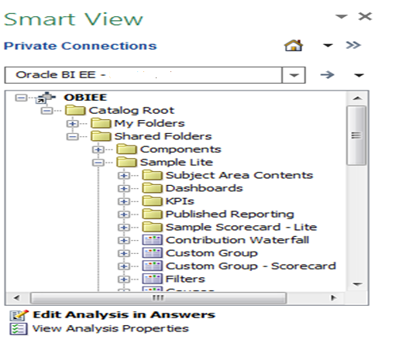
Smart View Overview Contd..
Catalog − The catalog is an expandable tree list of the BI Answers, dashboards, analyses, and views that are available to you for insertion into Excel.

Slide 9
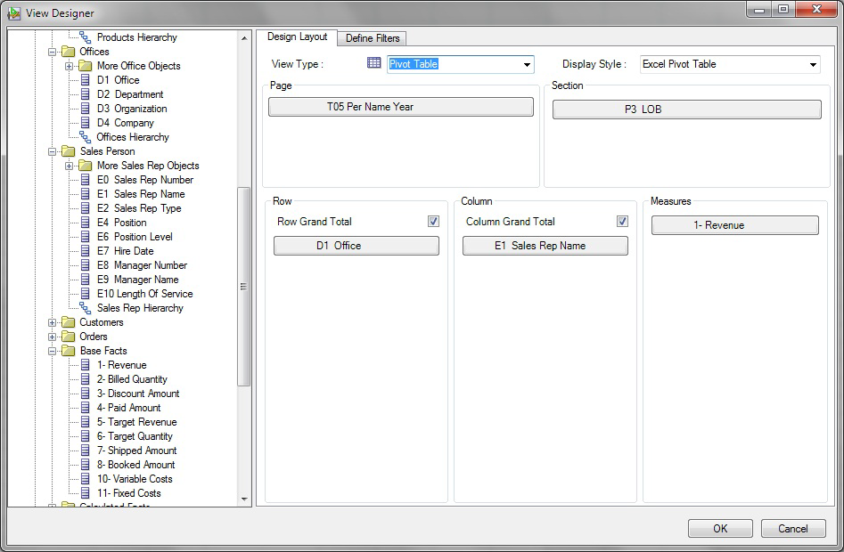
Smart View Overview Contd..
View Designer − View Designer in Smart View is used to create ad hoc views based on an Oracle BI EE subject area.

Slide 10
Smart View Overview Contd..
Filters – Normally defined when creating a new view by adding Filter columns.
Filter View – The filters defined are summarized in the Filter Summary pane.

Slide 11
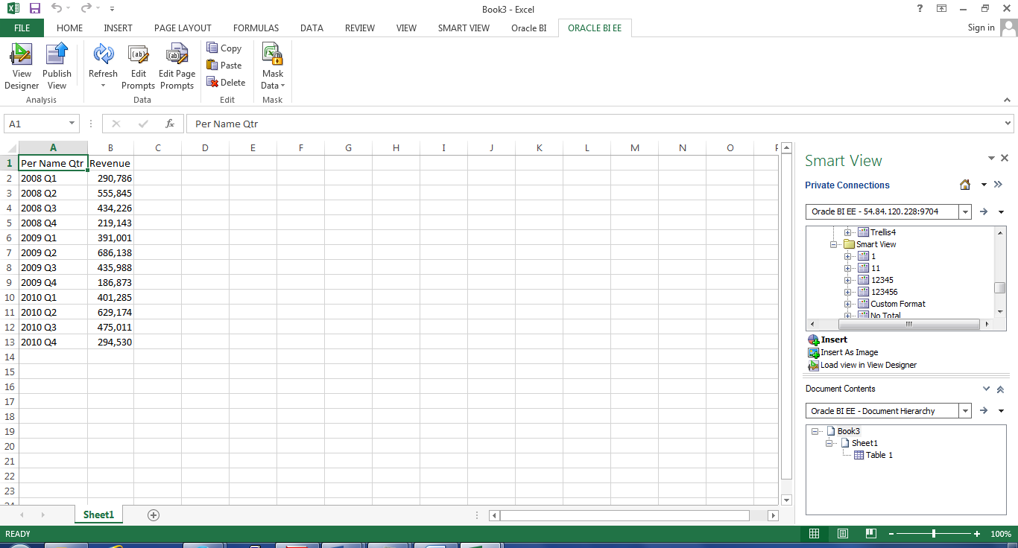
Smart View Overview Contd..
Table View

Slide 12
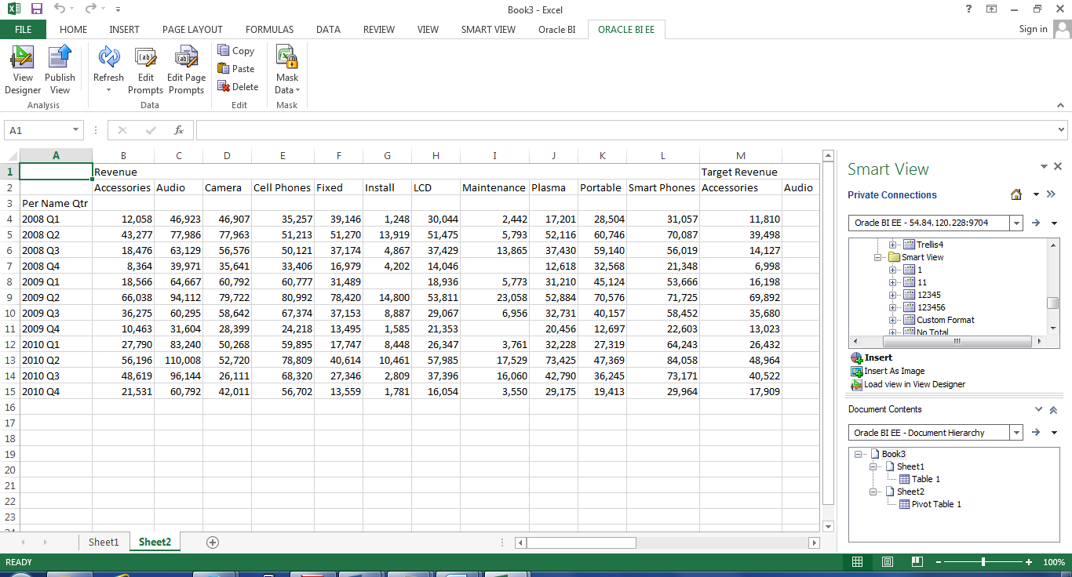
Smart View Overview Contd..
Pivot Table View

Slide 13
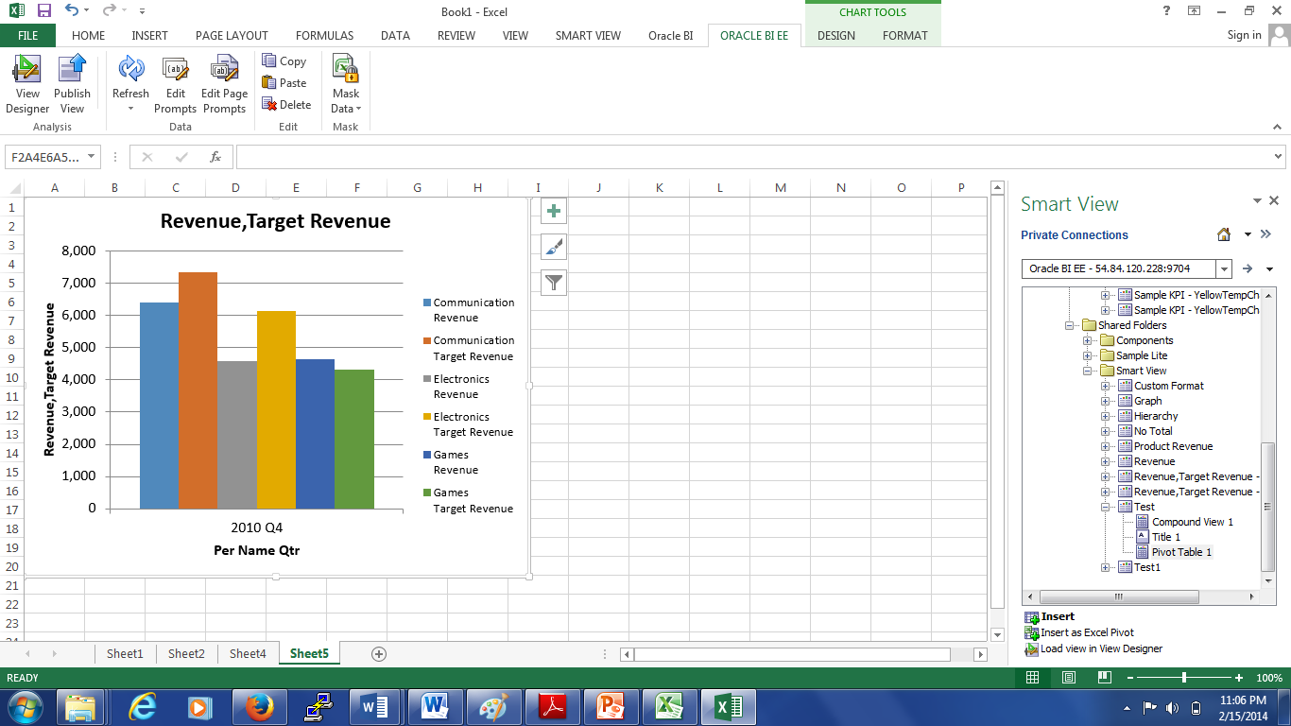
Smart View Overview Contd..
Graph View

Slide 14
Smart View Vs. Oracle BI Office Plug-in
Prior to 11.1.1.7 release of OBIEE, primary facility for interacting Oracle BI Content with Microsoft Office has been Oracle BI Office Plug-in. OBIEE release of 11.1.1.7 introduces Smart View as strategic direction for Microsoft Office integration.
Smart View Create new analysis using Oracle BI Catalog objects possible with “View Designer” option Upload or Publish newly created analysis back to Oracle BI Catalog for future access Supports all MS Office versions including 2013 Oracle’s future direction for Microsoft Integration - fully supported | BI Office Plug-in Creating new analysis was NOT possible with BI Office Add-in Publish or authoring to Oracle BI catalog was not an option Available for MS Office 2003, 2007, 2010 Only. Not supported for MS Office 2013 End of lifecycle has been instigated with limited support going forward

Slide 15
Smart View Limitations
There are some known limitations with this first release of Smart View planned to be supported in future releases:
When a pivot table view is inserted as an Excel Pivot table, prompts that are defined in BI Answers are not available.
Copying dashboard pages to Smart View doesn’t work.
Data in Word documents can only be masked in their entirely; you cannot mask data on individual pages in Word. But, in excel and power point selected pages or entire workbook can be masked.
Tables and pivot tables can be copied within and between Word and PowerPoint.
Tables and pivot tables cannot be copied within Excel, from Excel to another Office application, or from another Office application to Excel.
Smart View doesn’t support hierarchy.
Excel formatting options like adding a column or adding total doesn’t reflect in catalog after publishing.

Slide 16
Thank you
Questions?
Ref for Details: http://docs.oracle.com/cd/E51310_01/epm.11125/smart_view_user.pdf

